Slide 1
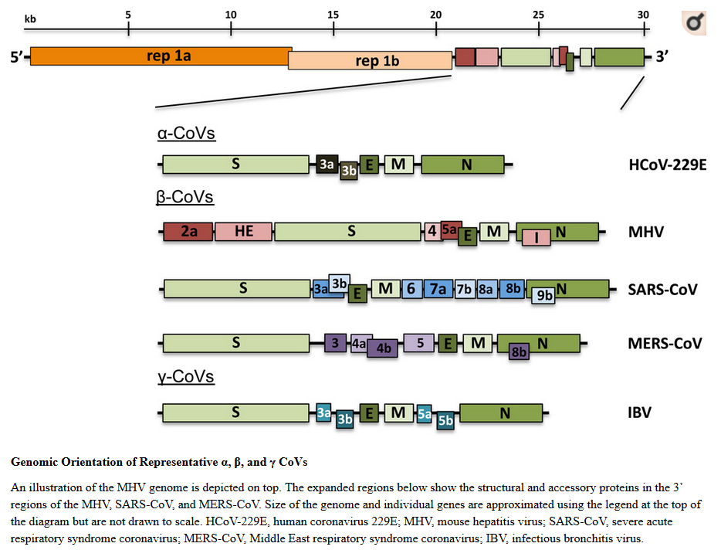
Coronaviruses
RNA viruses (Family – Coronaviridae)
Methods Mol Biol. 2015; 1282: 1–23.

Slide 2
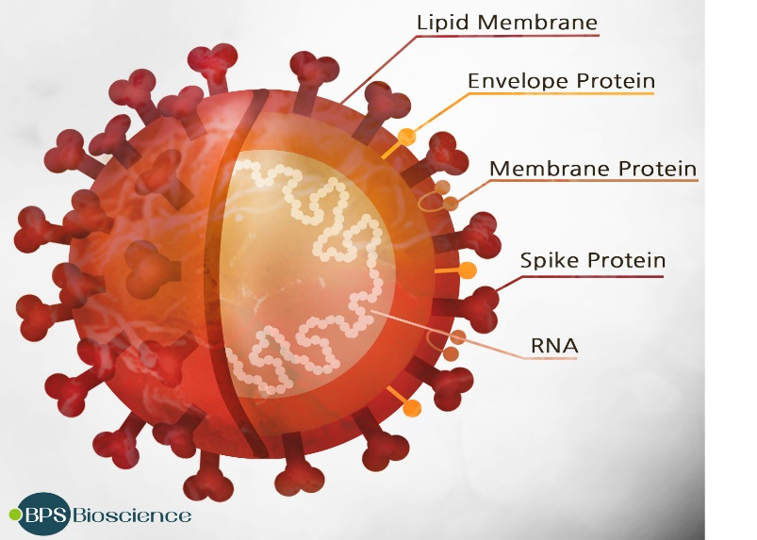
SARS-CoV-2
Causes COVID-19 disease
is an enveloped, non-segmented, positive sense single stranded RNA virus
https://www.google.com/url?sa=i&url=https%3A%2F%2Fbpsbioscience.com%2Fsars-cov-2-coronavirus-covid-19&psig=AOvVaw2cyE-DQlE6TYhmUolhB_yb&ust=1597419766160000&source=images&cd=vfe&ved=0CAIQjRxqFwoTCNCi-pTCmOsCFQAAAAAdAAAAABAK

Slide 3
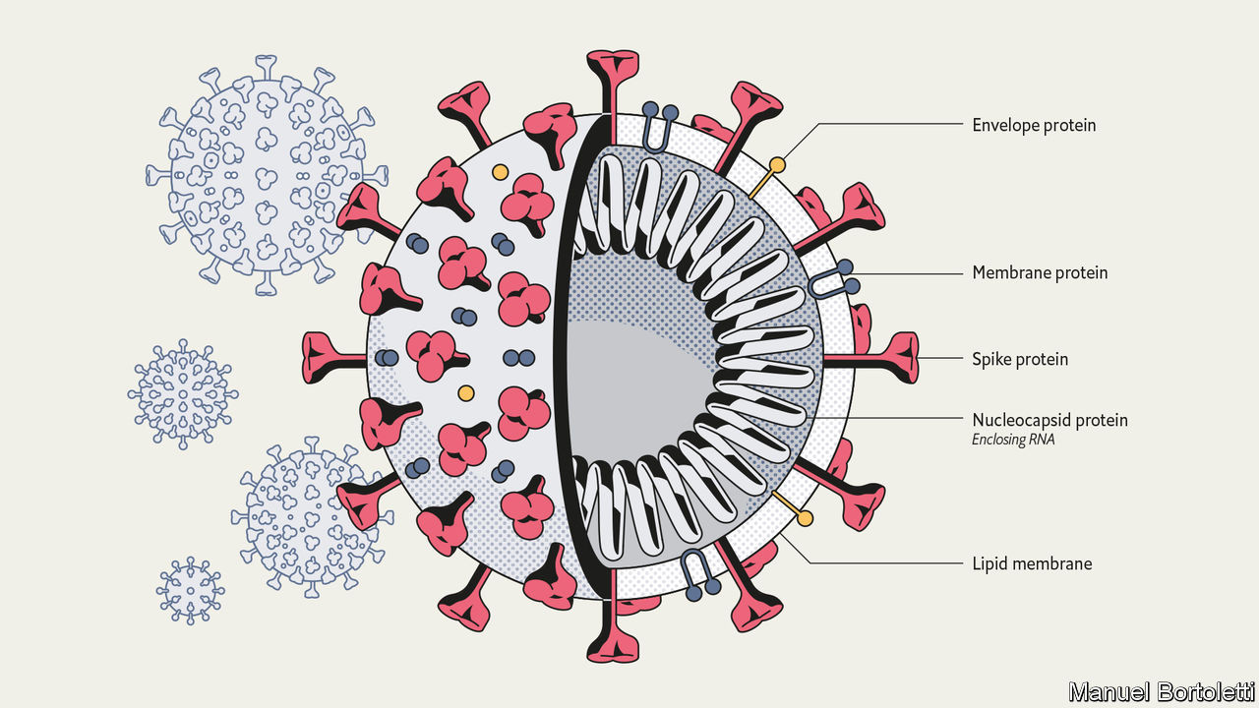
https://www.economist.com/briefing/2020/03/12/understanding-sars-cov-2-and-the-drugs-that-might-lessen-its-power

Slide 4
Origin
All CoVs that caused epidemics including SARS-CoV-2, are believed to originate in bats
All have intermediate hosts. SARS-CoV2 intermediate host unknown
In late 2019, SARS-CoV-2 outbreak in Wuhan, China
Declared as pandemic by the World Health Organization (WHO) on March 11, 2020

Slide 5
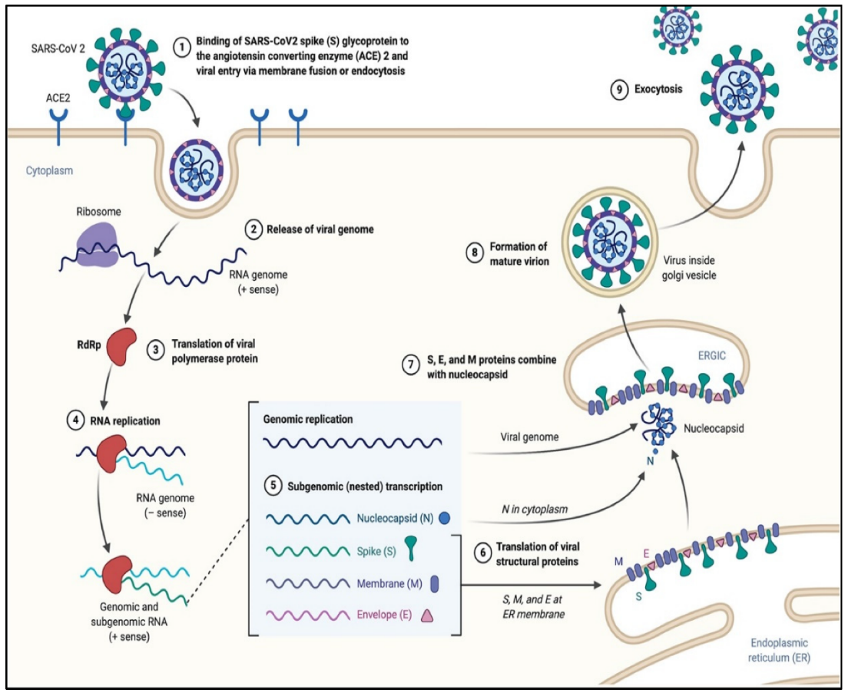
Infection

Slide 6
Transmission
Via respiratory droplets of an infected person (symptomatic, presymptomatic or asymptomatic) when he/she cough or sneeze
Droplets propelled a short distance can spread the virus
Touching infected surfaces
Other unknown ways

Slide 7
Types of Tests
Diagnostic testing
Molecular test – to detect genetic material
Antigen test – to detect protein on the surface of the virus
Antibody test
Looks for antibodies
To determine if someone has been infected in the past
Not recommended if someone is infected in present

Slide 8
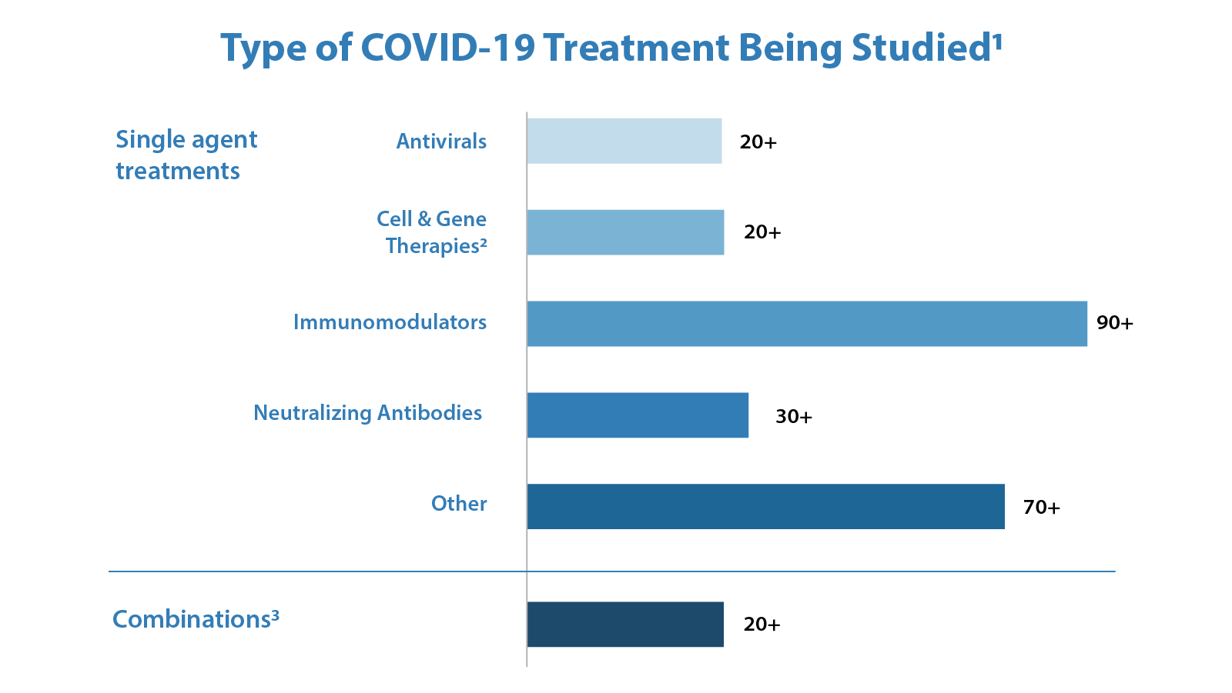
Treatments
Antiviral drugs under investigation
Remdesivir
Rivavirin
Kaletra etc.
https://www.fda.gov/drugs/coronavirus-covid-19-drugs/coronavirus-treatment-acceleration-program-ctap

Slide 9
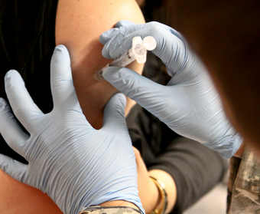
Vaccines to Prevent Viral infections
Trigger immune protection
Prepared using:
Attenuated “live” virus
(very small risk of infection)
“killed” virus
molecular subunits
Time consuming as it requires 6 stages – discovery, testing in cell cultures or animals models, clinical testing in humans, effectiveness and dosage, approval process, manufacturing and quality control
credit: USACE Europe District
Download for free at http://cnx.org/content/col11448/latest/

Slide 10
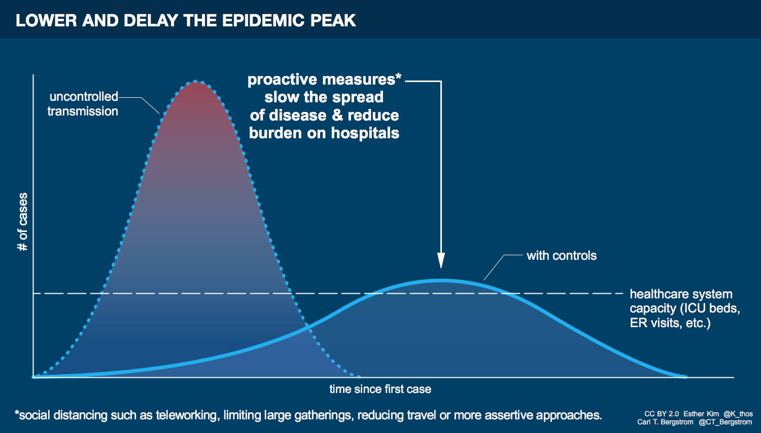
Mitigate spread
Limit contacts via physical distancing and contact tracing
Wearing masks in public
Watch https://www.nejm.org/doi/full/10.1056/NEJMc2007800.

